Slide 1
Explaining Credit Card Fraud Decisions in ML
An Analysis of XAI Methods
Ciaran Finnegan – Course: M.Sc. in Computing (Data Science)
Student: D21124026

Slide 2
Motivation
How to propose developments in the use of ‘explainability’ techniques in credit card fraud

Slide 3
Motivation
Background of interest/professional involvement in the application of ML to financial crime prevention software.
Emerging Product Management interest around integrating ‘explainability’ in fraud detection model output.
This includes assessing the benefits of different techniques.
Access to new and ‘almost real’ world credit card fraud data on which to experiment and test hypotheses.

Slide 4
Background + Literature Review
Key themes in current research

Slide 5
Background and Literature Review
Key Themes
It is not enough to stop the fraud; the machine needs to tell you why?
How to measure the effectiveness of an explanation? What makes it good? Consensus is hard to find.
Humans can give you their assessments – but they can be expensive, stupid, or prejudiced (or all three).
Can the value of XAI output, particularly from an NN ‘black box’, be assessed using an objective/statistical process?
There are examples of ML research in the area of objective XAI comparisons in the Healthcare domain; can this be applied to CC Fraud?

Slide 6
Chosen Research Problem
An objective analysis of XAI techniques in card fraud detection/explanation

Slide 7
Research Problem – Automate XAI Method Evaluation?
Null Hypothesis:
It is not possible to quantify and distinguish the statistically best interpretation framework to explain the reason for a specific (local) credit card fraud classification result using the following state-of-the-art techniques; SHAP, LIME, ANCHORS, and DICE.
Alternate Hypothesis:
IF a Neural Network algorithm is trained on a credit card transaction dataset for ML fraud detection, and SHAP, LIME, ANCHORS, and DICE interpretability frameworks are applied to individual model results
THEN a test for significance can be applied to the scores of each interpretability framework, against a predefined set of quality metrics, to rank each explainer technique and to demonstrate statistically which is best for explaining local credit card fraud classification results.

Slide 8
Research Problem – Automate XAI Method Evaluation?
Null Hypothesis:
It is not possible to quantify and distinguish the statistically best interpretation framework to explain the reason for a specific (local) credit card fraud classification result using the following state-of-the-art techniques; SHAP, LIME, ANCHORS, and DICE.
Alternate Hypothesis:
IF a Neural Network algorithm is trained on a credit card transaction dataset for ML fraud detection, and SHAP, LIME, ANCHORS, and DICE interpretability frameworks are applied to individual model results
THEN a test for significance can be applied to the scores of each interpretability framework, against a predefined set of quality metrics, to rank each explainer technique and to demonstrate statistically which is best for explaining local credit card fraud classification results.
SHAP

Slide 9
Research Problem – Automate XAI Method Evaluation?
Null Hypothesis:
It is not possible to quantify and distinguish the statistically best interpretation framework to explain the reason for a specific (local) credit card fraud classification result using the following state-of-the-art techniques; SHAP, LIME, ANCHORS, and DICE.
Alternate Hypothesis:
IF a Neural Network algorithm is trained on a credit card transaction dataset for ML fraud detection, and SHAP, LIME, ANCHORS, and DICE interpretability frameworks are applied to individual model results
THEN a test for significance can be applied to the scores of each interpretability framework, against a predefined set of quality metrics, to rank each explainer technique and to demonstrate statistically which is best for explaining local credit card fraud classification results.
LIME

Slide 10
Research Problem – Automate XAI Method Evaluation?
Null Hypothesis:
It is not possible to quantify and distinguish the statistically best interpretation framework to explain the reason for a specific (local) credit card fraud classification result using the following state-of-the-art techniques; SHAP, LIME, ANCHORS, and DICE.
Alternate Hypothesis:
IF a Neural Network algorithm is trained on a credit card transaction dataset for ML fraud detection, and SHAP, LIME, ANCHORS, and DICE interpretability frameworks are applied to individual model results
THEN a test for significance can be applied to the scores of each interpretability framework, against a predefined set of quality metrics, to rank each explainer technique and to demonstrate statistically which is best for explaining local credit card fraud classification results.
ANCHORS

Slide 11
Research Problem – Automate XAI Method Evaluation?
Null Hypothesis:
It is not possible to quantify and distinguish the statistically best interpretation framework to explain the reason for a specific (local) credit card fraud classification result using the following state-of-the-art techniques; SHAP, LIME, ANCHORS, and DICE.
Alternate Hypothesis:
IF a Neural Network algorithm is trained on a credit card transaction dataset for ML fraud detection, and SHAP, LIME, ANCHORS, and DiCE interpretability frameworks are applied to individual model results
THEN a test for significance can be applied to the scores of each interpretability framework, against a predefined set of quality metrics, to rank each explainer technique and to demonstrate statistically which is best for explaining local credit card fraud classification results.
DiCE

Slide 12
Experiments: Design + Methodology
Research objectives

Slide 13
XAI: Custom Metrics to Score Each Technique
Metric 1: IDENTITY
How many identical instances have identical explanations?
Distance between most similar instances = Distance between associated explanations.
Build a performant NN CC Fraud predictive model with dataset.
Prove XAI methods produce meaningful explanations.
Score each XAI technique against a set of custom-built metrics (inspired by similar ML experiment with Healthcare data).
Metric 2: STABILITY
Instances belonging to the same class have comparable explanations.
Instances/Explanations cluster in same ‘Fraud’/’Non-Fraud’ clusters.
Metric 3: SEPERABILITY
Dissimilar instances must have dissimilar explanations.

Slide 14
XAI: Custom Metrics to Score Each Technique
Metric 4: SIMILARITY
The more similar the instances, the closer their explanations are to each other.
The ‘scores’ from each XAI experiment provide the input to a statistical analysis experiment.
This experiment assesses if there is any significant difference between the performance of the XAI techniques.
Metric 5: COMPUTATIONAL EFFICIENCY
Time taken to generate a set of explanations.
Why included? Relevant metrics for commercial applications.

Slide 15
Experiments: Implementation
Generating and evaluating XAI custom metrics

Slide 16
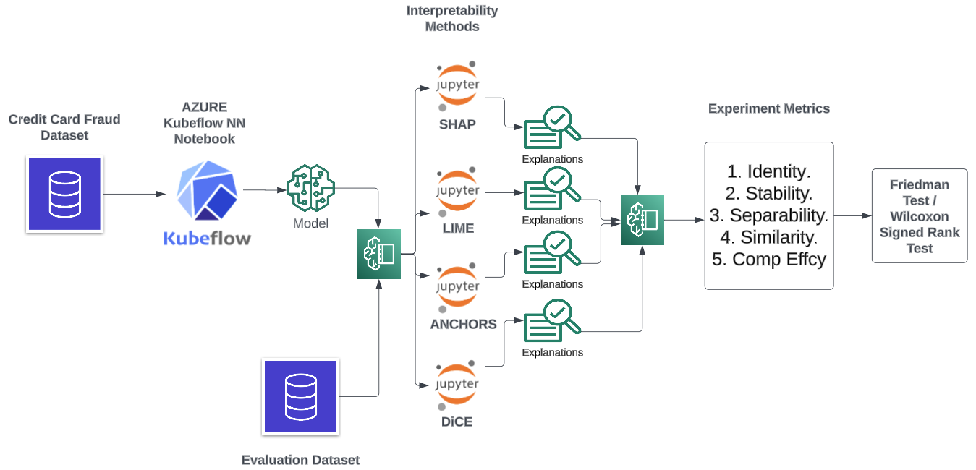
Experiment Structure
Implemented as a modular framework of Python files.
NN Model built from training data split.
XAI explainers built from training/test/full dataset, as required by each given implementation library.
Test data (in ‘chunks’) used to generate actual explanations for scoring.
Score date fed into analysis and processed (also a Python .ipynb file)
https://github.com/JackDaedalus/Dissertation.git

Slide 17
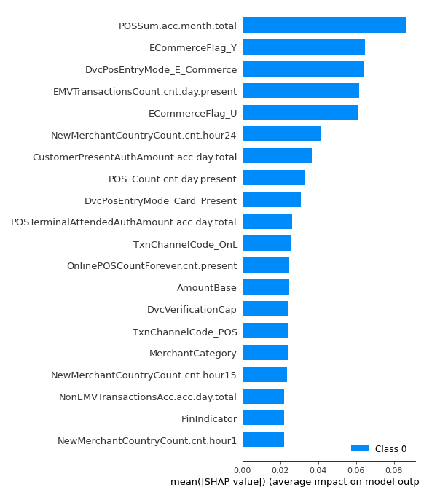
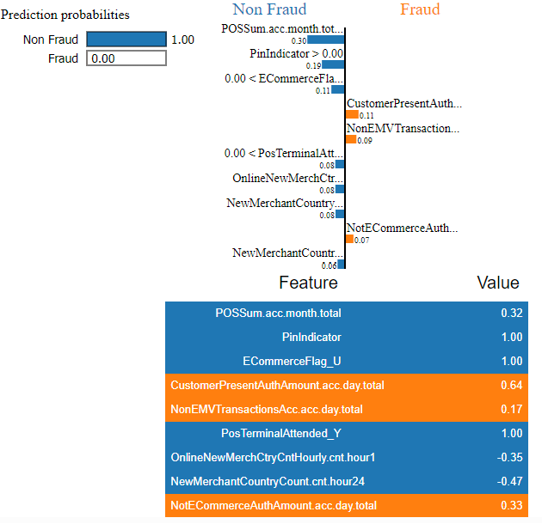
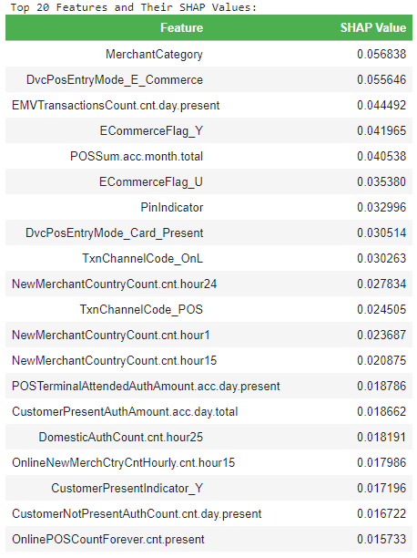
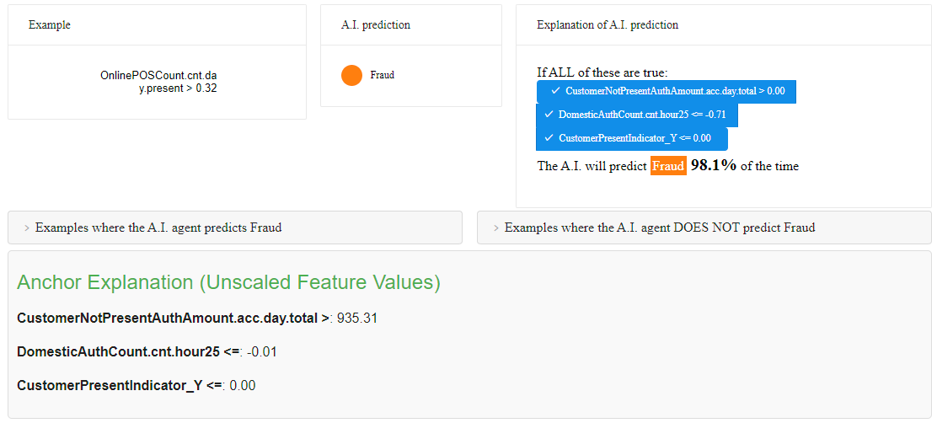
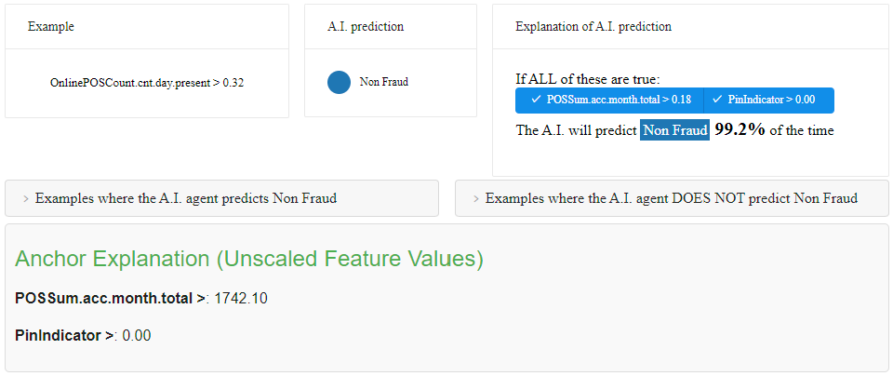
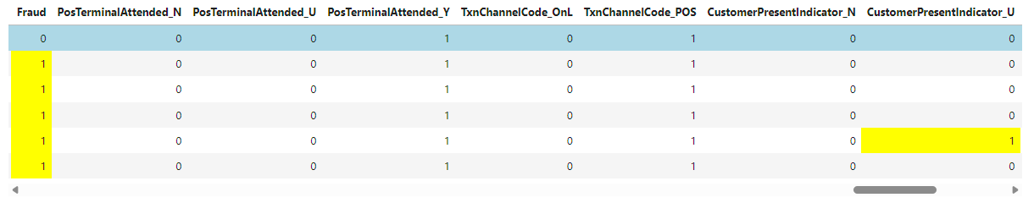
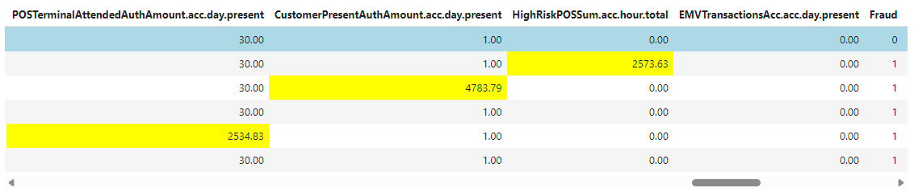
Pre-Experiment Question: Meaningful XAI Output?

Slide 18
Experiments: Results
What do the experiments reveal?

Slide 19
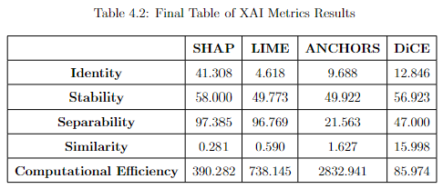
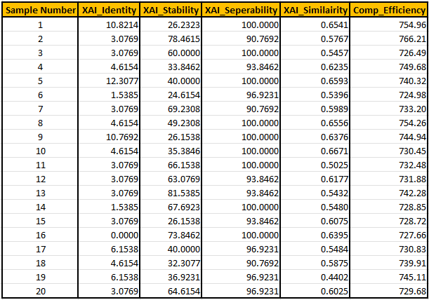
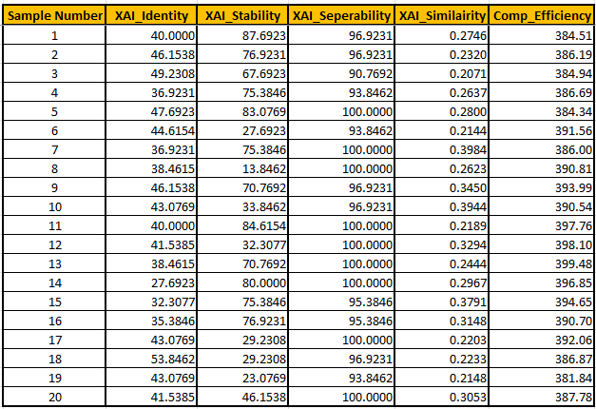
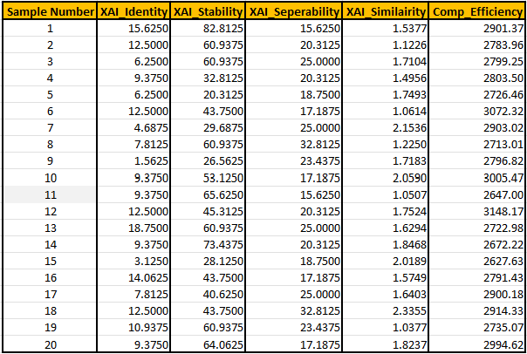
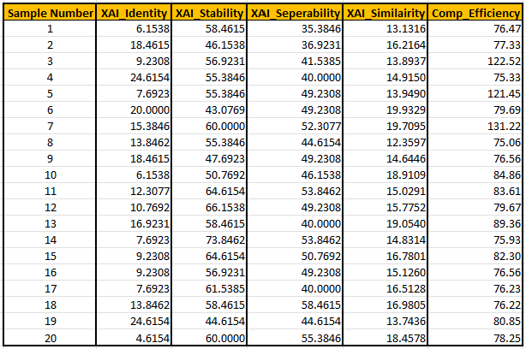
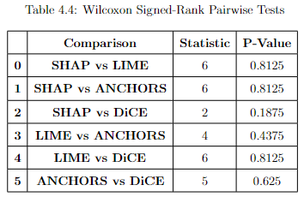
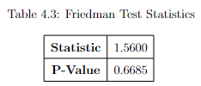
XAI Metric Scores
These experiment results confirm the NULL Hypothesis that the XAI methods do not differ significantly in their performance.
No ranking can be applied to the XAI methods (based on the experiment conditions).

Slide 20
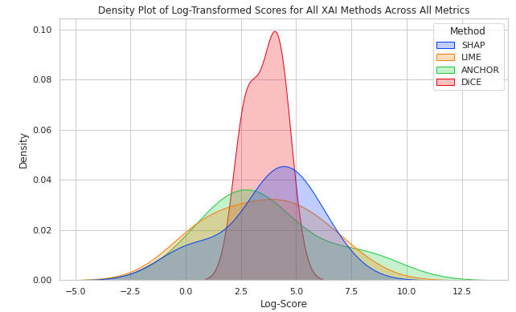
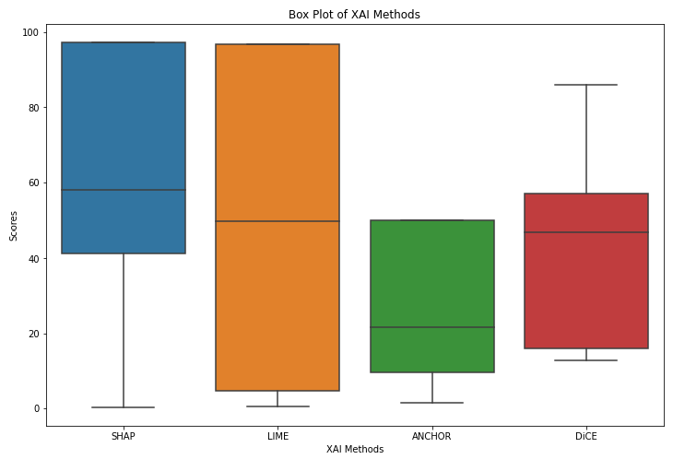
Statistical Analysis of XAI Scores

Slide 21
Contribution + Impact
What insight do the outcomes provide?

Slide 22
Contributions and Impact
The experiments were successful in building an objective statistical framework to compare XAI methods, but…
Would it be enough to convince a financial crime Product Manager to forgo human-centric survey? Perhaps, but the scope of the experiments needs to increase.
If SHAP has no obvious competitor for ‘good’ explanations – why keep looking?
Will the benefit of some XAI explanations, like Anchors and DiCE, always be ‘in the eye of the beholder”?

Slide 23
Contributions and Impact
Also…
“Context is for Kings”
The interaction of the XAI methods with the credit card dataset must be to considered in parallel with the custom metric results.
For example;
Why did Anchors take so long to compute?
Why did DiCE require additional features?

Slide 24
Future Work + Recommendations
Quo Vadis?

Slide 25
Future Work and Recommendations
Broaden XAI methods to improve insight on how new explainability procedure perform on the credit card data.
The experiment structure provides an effective, consistent, and repeatable framework into which to ‘plug’ other interpretability techniques (LORE, ILIME, MAPLE, etc.), and new datasets.
Create new custom metrics to increase range of automated criteria designed to rate a ‘good’ explanation.

Slide 26

Questions?

Slide 27
Question preparations…
Can you find any literature or previous research to back up the DiCE Counterfactual problems with binary features?
Can you find any literature or previous research to back up the Anchors computational overhead problems?
Have a list of ‘sound bites’ for each custom metric to elaborate on its workings.
Related to above – why is each one different to each other?

Slide 28
Add a Slide Title - 1

Slide 29
Research Problem

Slide 31
Add a Slide Title - 4

Slide 32
XAI: Custom Metrics to Score Each Technique
Build a performant NN CC Fraud predictive model with dataset.
Prove XAI methods produce meaningful explanations.
Score each XAI technique against a set of custom-built metrics (inspired by similar ML experiment with Healthcare data).
Step 1 Title
Step 2 Title
Step 3 Title
Task Description
Task Description
Task Description
Task Description
Task Description
Task Description

